Slide 1
Putting Pen to Paper
Peter Bower
NIHR School for Primary Care Research, University of Manchester
Sabine van der Veer
Division of Informatics, Imaging and Data Sciences
David Schultz
Centre for Atmospheric Science, Dept of Earth and Environmental Sciences, and
Centre for Crisis Studies and Mitigation
S
Notes:
1

Slide 2
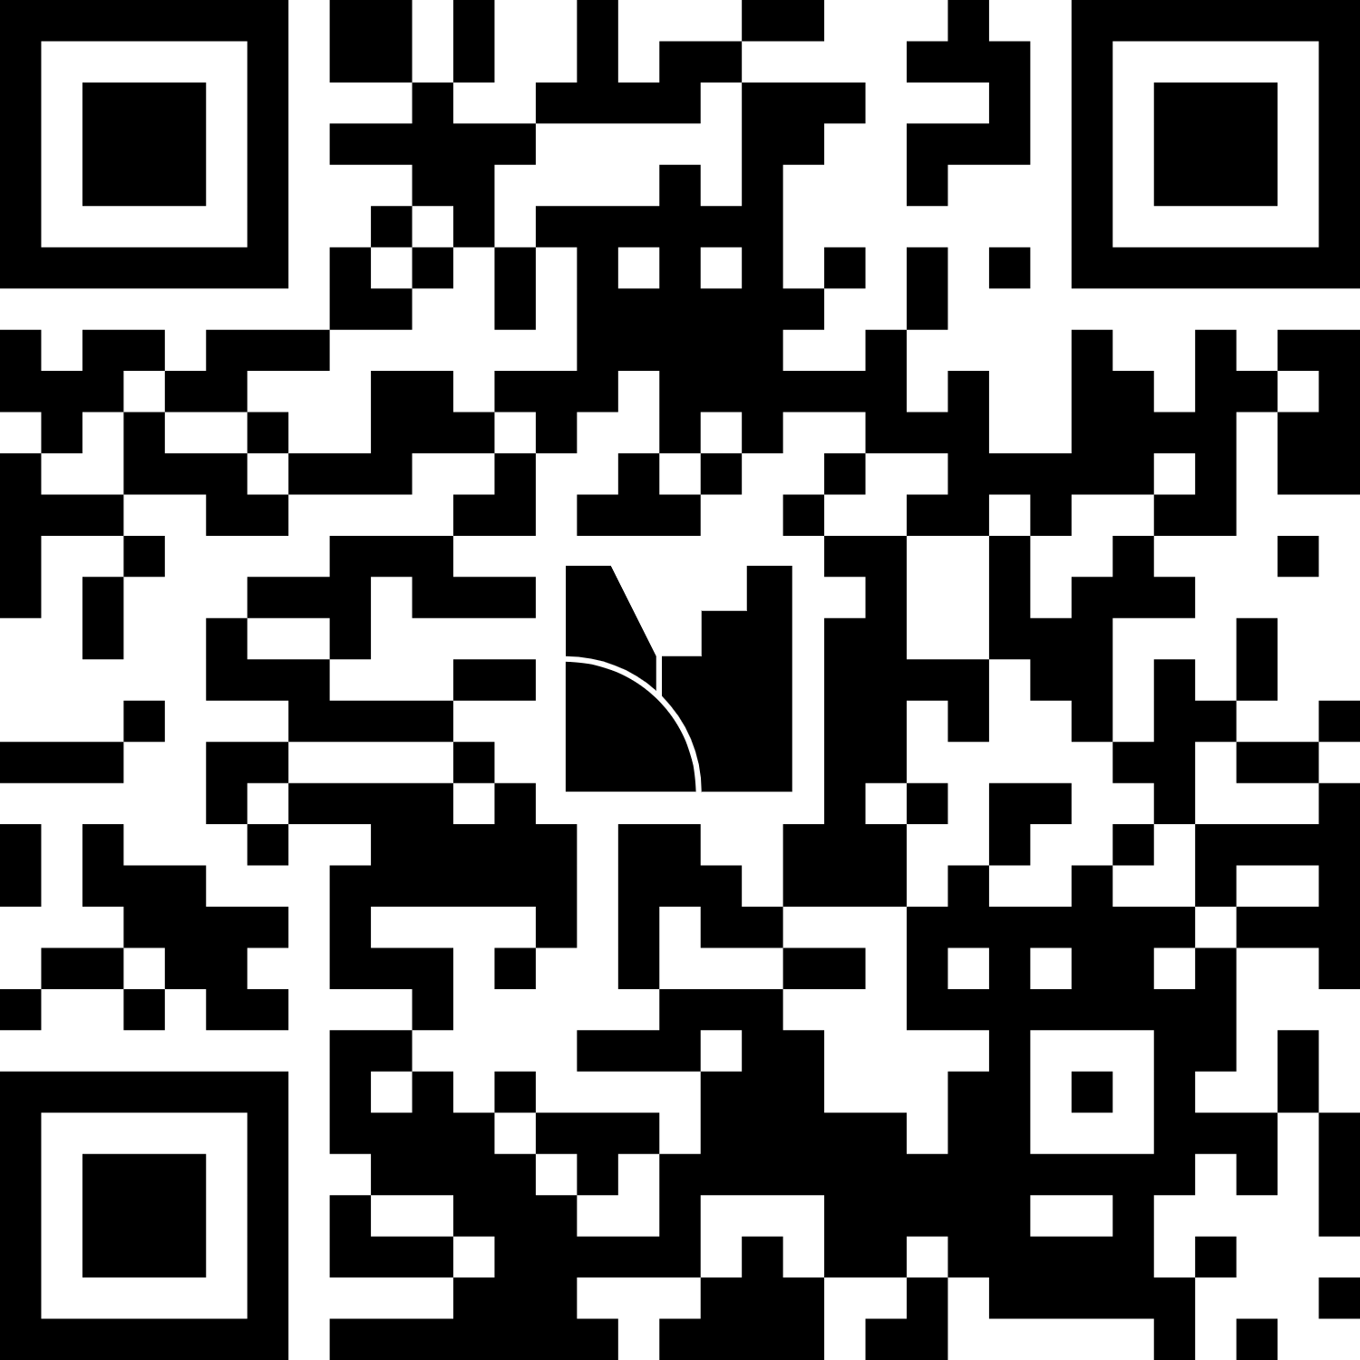
What is your experience of writing and submitting grant applications?
Scan the QR code or go to menti.com and use code 4455 1244
Notes:
In the pre-GWR briefing, delegates already indicated the following topics of interest for us to touch on: EDI, Environmental sustainability, costings & budgets, how to organise a grant into WPs
Menti-meter with 2 questions:
- Have you ever submitted a grant application? (however small) – can ask the room what funders and if people have been successful
What were (or would you expect to be) the key challenges throughout the process?

Slide 3
What you will learn in this session:
What is a strong rationale for a research project?
How to build and manage a team of co-applicants?
Understanding calls and funders
Highlighting value and impact
Communicating your ideas
S
Notes:
3

Slide 4
Two Fundamental Principles of Communication
D
Notes:
Science Communication: A Practical Guide for Scientists. Bowater and Yeoman, Wiley–Blackwell

Slide 5
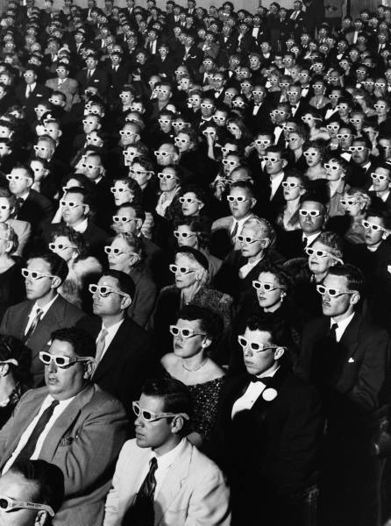

Audience
Message

Slide 6
So what?
The most important question you can ask about communicating your research
Notes:
Science Communication: A Practical Guide for Scientists. Bowater and Yeoman, Wiley–Blackwell

Slide 7
A strong rationale is a good research question linked to an important yet unmet clinical or population health need
Notes:
Science Communication: A Practical Guide for Scientists. Bowater and Yeoman, Wiley–Blackwell

Slide 8
Do you have a strong rationale for your research?
Lots of good science does not get funded, and occasionally some bad science does.
But, a strong rationale is the basis of having the best chance at funding.
Notes:
Science Communication: A Practical Guide for Scientists. Bowater and Yeoman, Wiley–Blackwell

Slide 9
Knowledge gaps alone are seldom a strong rationale for research. If no one has studied a particular topic, there might be a good reason. Not every knowledge gap is worth addressing. Instead, address gaps that help solve problems that matter.
https://lennartnacke.com/why-research-gaps-are-bullsh1t
Notes:
Research gaps are not the best way to motivate the research. Not all gaps are important. https://lennartnacke.com/why-research-gaps-are-bullsh1t/ That is why we advocate for a problem statement to motivate the research.

Slide 10
Instead of asking "What hasn't been studied?”, start with asking yourself: What are pressing clinical or public health problems, and how can my research help address these? What are the existing inconsistencies, tensions, or contradictions in the current understanding of these problems? What are the limitations of current approaches and solutions, and why do these limitations matter?
Based on: https://lennartnacke.com/why-research-gaps-are-bullsh1t
Notes:
Research gaps are not the best way to motivate the research. Not all gaps are important. https://lennartnacke.com/why-research-gaps-are-bullsh1t/ That is why we advocate for a problem statement to motivate the research.

Slide 11
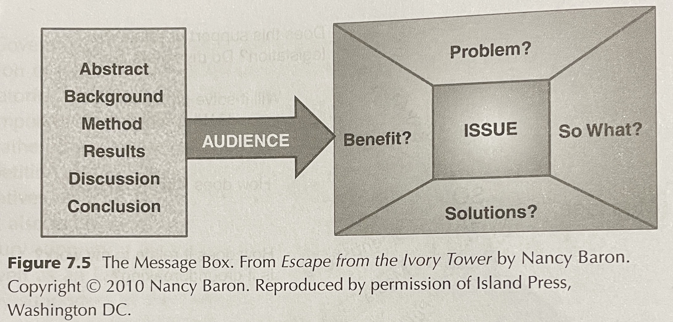
The Message Box as a tool to construct your proposal
Bowater and Yeoman (2013): Science Communication: A Practical Guide for Scientists.
S
Notes:
Science Communication: A Practical Guide for Scientists. Bowater and Yeoman, Wiley–Blackwell

Slide 12
The message box can help you:
Craft the rationale for your proposal
Polish your critical literature review
Explain to nonscientists what you do
Prepare for interviews
Refine your elevator speech

Slide 13
Clinical or public health need
ISSUE: In broad terms, what is the overarching issue or topic?
PROBLEM: What is the particular problem or piece of the issue I am addressing?
SO WHAT?: Why does this matter to others?
Knowledge gap (research question)
SOLUTIONS: What is (still un) known about the potential solutions to the problem?
BENEFITS: What is (still un) known about the potential benefits from resolving the problem?

Slide 14
Example message box
Issue: x million people live with disease Y which negatively impacts their quality of life
Problem: exposure Z causes the disease to progress but assessment is infrequent and currently relies on self-report
So what: this means the disease is suboptimally managed, with many people progressing unnecessarily quickly
Solution: research in another disease showed approach B improved assessment but unclear if and how this translates
Benefits: evidence that feedback on exposure Z supports self-management but clinical utility is still unknown

Slide 15
Now you have a go defining a message box for your project
Notes:
People find their group and take 10 mins to do this for their project – then ask 1 group (or 2 if time allows) to report back
Activity takes ~20 mins incl feedback

Slide 16
Question, aim, objectives
Research question: central question of your study (linked to knowledge gap)
Aim: what you want to achieve with your research (by answering your research question)
Objectives: how you will achieve your aim (strong link to your methods and deliverables)
All should follow logically from your rationale and ultimately contribute to addressing the clinical/health need

Slide 17
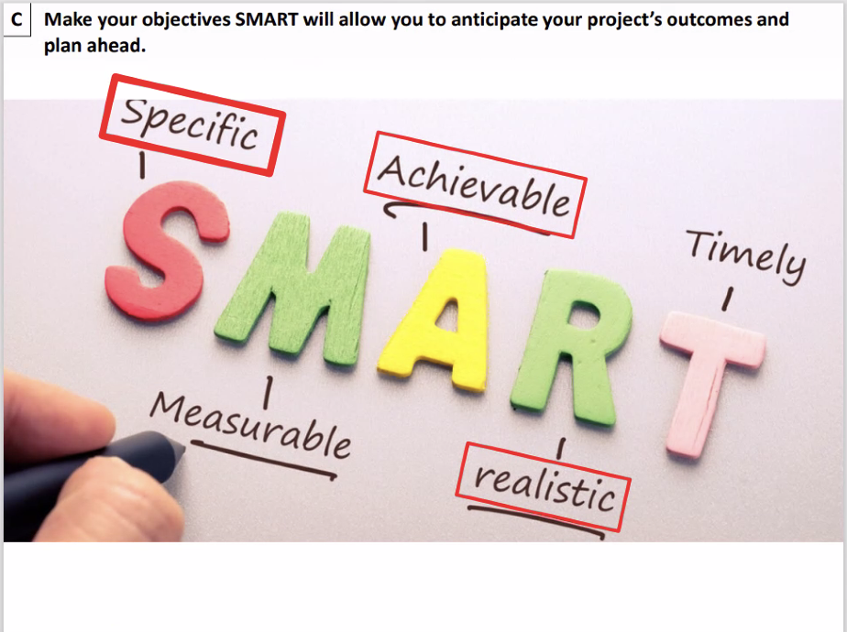
(Jean-Baptiste Koehl)

Slide 18
Example message box
Issue: x million people live with disease Y which negatively impacts their quality of life
Problem: exposure Z may cause disease Y to progress but assessment is infrequent and currently relies on self-report
So what: this means disease Y is suboptimally managed, with many people progressing unnecessarily quickly
Solution: research in another disease showed approach B improved assessment but unclear if and how this translates
Benefits: evidence that feedback on exposure Z supports self-management but clinical utility is still unknown

Slide 19
Example aim & objectives
Aim: Improve assessment of exposure Z to inform treatment of disease Y (using approach B) [problem]
Objectives: [unknowns re: solutions & benefits]
Test accuracy of approach B to assess exposure Z in people with disease Y in (a) controlled and (b) real-world settings
Explore the clinical utility of approach B to inform treatment of disease Y
Ultimately, this will contribute to enhancing management of disease Y, slow progression, and improve quality of life [issue; so what]

Slide 20
Now you have a go defining the aim and objectives for your project
Notes:
Follows on from previous message box activity (~10 mins). Ask another group to feed back.

Slide 21
Background
on funding agency,
call for proposals
P

Slide 22
Know the context for the call for proposals. Are you eligible? Are there favored competitors due to how the call for proposals was written? Call the program manager to discuss your proposal, if possible.

Slide 23
What are they looking for? Pay attention to the criteria by which the proposal will be judged. Talk with prior applicants (particularly successful ones). Get copies of previous submissions.

Slide 24
Understand the panel
D

Slide 25
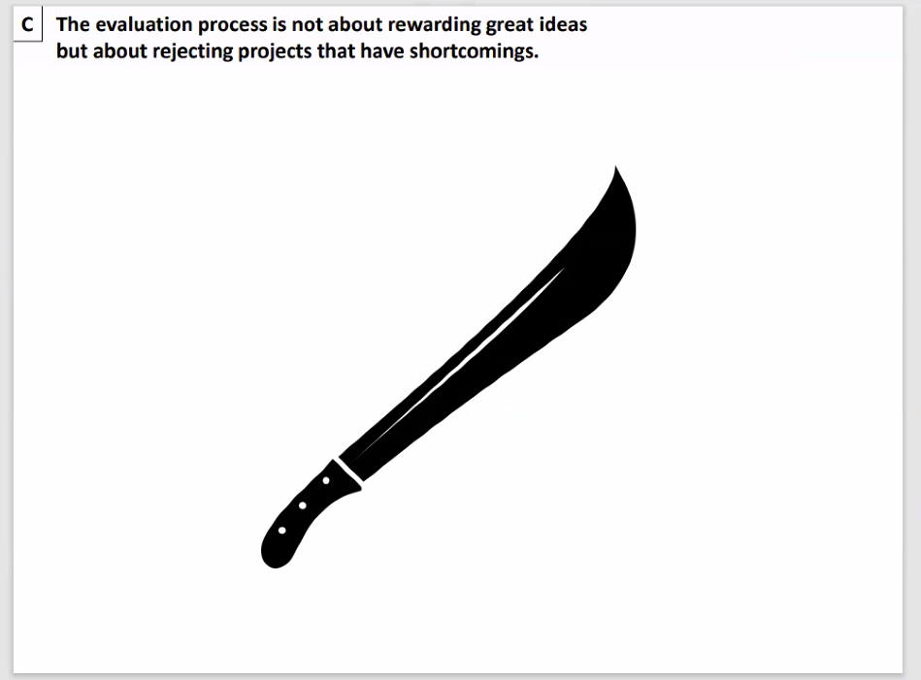
(Jean-Baptiste Koehl)

Slide 26
Know your audience and write the proposal accordingly. Will generalists be on the panel? (Much more likely for awards and fellowships.) Will specialists be reviewing the proposal? What do your funders SAY they want to fund? Any relevant priority setting work?

Slide 27
Address the concerns of the reviewers/panel/funding agency.
Talk at a level that they can understand.
Use clever analogies, demonstrations, stories, or examples to explain difficult concepts.
Notes:
I haven’t heard many stories of how claiming you’re a synoptic meteorologist has increased personal wealth, brought fame, or even made someone more attractive to the opposite sex. Simply put, there aren’t many days where it is cool to claim you’re a synoptician. Today, however, is one of those days.
Synoptic meteorology has a reputation of being less rigorous than other disciplines, perhaps rightly so in some instances. But, Fred Sanders and his colleagues Dick Reed and Chester Newton, provided legitimacy to our discipline by merging the application of dynamics and quantitative diagnosis with the study of observed weather systems. For my talk, I want to review Fred’s contributions to synoptic meteorology, and focus on cold fronts, specifically.

Slide 28
Manage and mitigate risks in your proposal.
Things can and WILL go wrong.
Reviewers will expect you to have alternative plans.
Be proactive in addressing weaknesses, perceived weaknesses, and things that you don’t even imagine to be weaknesses.
Notes:
28

Slide 29
Structuring and writing the proposal

Slide 30
Ensure a strong opening to the proposal. Never underestimate the importance of first impressions.

Slide 31
Write a strong problem statement. The problem statement is the hinge around which your proposal rotates.

Slide 32
A good introduction has three parts.
Contextualizing background information
Grounds the reader in familiar information
Problem statement
Hook to get reader into the paper
Conflict, controversy, paradox, errors, unknowns, inconsistencies
Response to the problem
How are you going to resolve the problem statement?
Notes:
32
Gov

Slide 33
Background and Literature Synthesis
Should not read like a grocery list:
“Paper A did this. Paper B did that. Paper C did something else.”
Describe the topics, not the papers themselves.
Be complete, within reason and within scope of the proposal.
Be up to date.
Include references that disagree with each other and that you disagree with.
Notes:
33
Gov

Slide 34
Say why you are the best to solve this problem. If you don’t have the skills to deliver, how will you obtain those skills? Training? Collaboration?

Slide 35
Say why this problem is timely. Why is this research needed now?

Slide 36
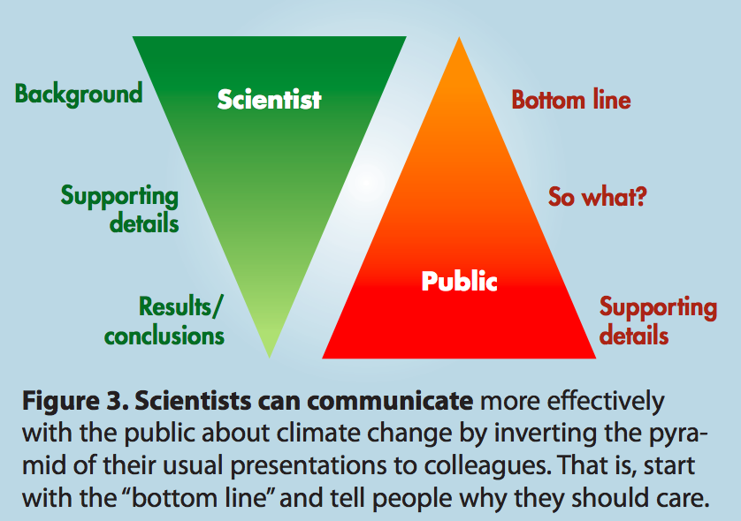
(Somerville and Hassol 2001, Physics Today)
Notes:
36

Slide 37
Get the killer material up front and be concise. In one or two paragraphs, give an overview of the proposal with background information, the problem statement, why the problem statement is bad, how only you are poised and able to save the day.

Slide 38
Which is the best opening sentence for a proposal? 1. “This proposal is about health app use and its effect on rates of depression.” 2. I am applying for a fellowship to support my research which is about the changing rates of depression in the context of mobile phone use.” 3. “Many scientists have been debating the role of app use on mental health.” 4. “Depression is increasing due to recent changes in people's use of phone apps.”

Slide 39
Follow the instructions precisely. Read the instructions multiple times during the preparation of the proposal.

Slide 40
Where allowed, break your proposed research into bite-sized chunks.
Work packages (WPs) break up what could be a complex task to look credible and doable.
If one WP has weaknesses, the rest of the proposal could still be salvaged.
WPs improve your planning, creating milestones for work accomplished along the way.
WPs show the coordination with the Gantt chart.
For multi-CoI proposals, WPs help demonstrate roles and responsibilities among the team.

Slide 41
Don’t neglect the aesthetics
P

Slide 42
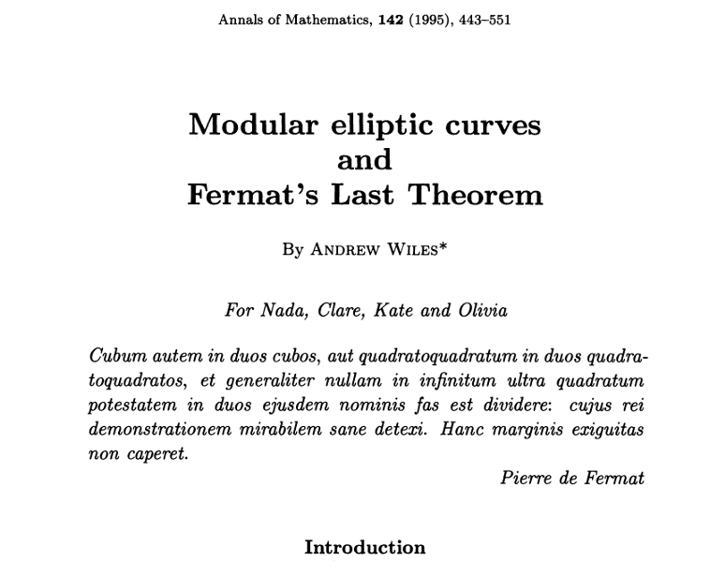

Slide 43
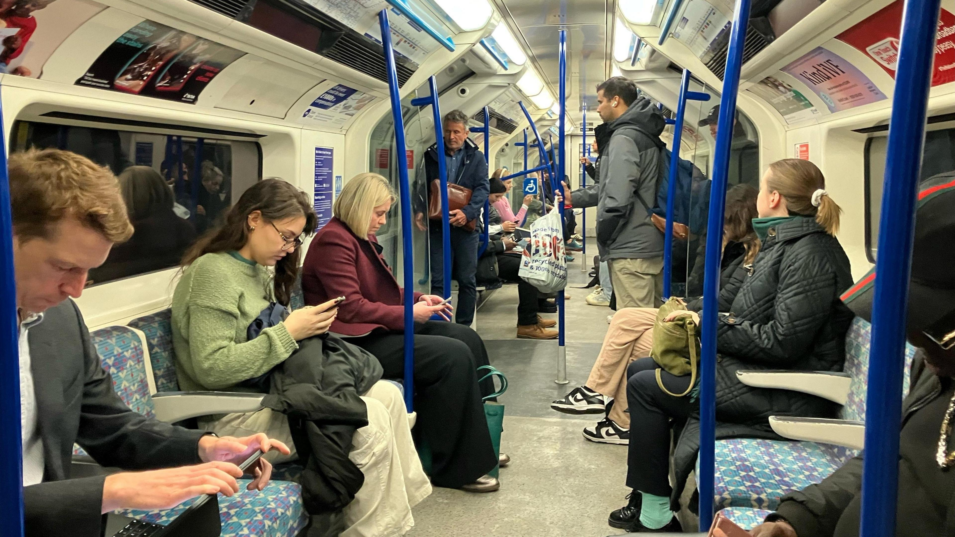

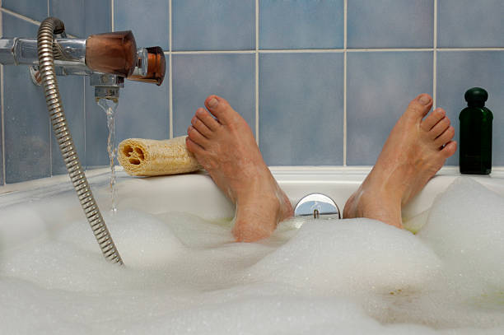

Slide 44
Make the submission readable, professional, and beautiful. Fill up the required fields, but don’t cram text into page limits Make the most of fonts (but don’t over do it) Word limits are maximums, not targets Use the skills of precision and concision to tighten the message in less text (“Omit needless words”)

Slide 45
Acronyms are supposed to make life easier for the reader not the author!
Spell out acronyms on first usage.
Avoid introducing new acronyms unless absolutely essential.
If you use an acronym only a few times, do not introduce it.
Notes:
45

Slide 46
Finances:
Building a Budget
S

Slide 47
Budgeting tips
Check funder guidance (eg, eligible costs, funding limits)
Start from the study design but check early if delivery will be feasible within the funding limit
Harness institutional support and expertise from the start
Budget research staff time first with need/feasibility of staff recruitment in mind
Budget non-staff costs per activity, get quotes where possible, don’t forget VAT, and ask someone to check nothing is missing
Adequately resource PPIE and knowledge mobilization/dissemination (check for funder guidance)
Ensure value for money by justifying why costs are needed
Notes:
47

Slide 48
Equality, Diversity, Inclusion and Accessibility
(EDIA)

Slide 49
Items to Consider
Development of others and maintenance of effective working relationships
List training done by team (e.g., unconscious bias)
Ensure recruitment is to ensure commitment to EDIA and reaching of diverse audiences
Demonstrate past experiences (breadth of applications, where postdocs have ended up)
Conference accommodations (including child care)
Demonstrate awards for individuals and universities (Athena Swan, Proud Employers Accreditation, Disability Confident Leader, etc.)
Follow guidance for inclusive research (eg, NIHR Inclusive Research guidance) and related activities are covered by your budget

Slide 50
Environmental Sustainability
D

Slide 51
Five Areas to Target
Project administration and management
Online meetings
Shared documents rather than large attachments
Collaboration tools (e.g., Teams, Slack)
Include sustainability sessions in your meetings
Materials and objects
Reduce/reuse/recycle
Research activities
Minimize travel
Consider impacts of computing, particularly generative AI
If you must travel, can you combine activities?
Is your lab LEAF certified?
Courtesy Faculty of Humanities

Slide 52
Five Areas to Target
Events
In-person, online or hybrid?
Accessible to target audience (e.g, reduced travel)?
Catering is locally sources, seasonal, and plant-based
Go paperless
Skip the freebies
Post-project legacy
What happens with all the stuff we created?
Include sustainability in training for researchers,
partners, etc.
Share your experiences with sustainability with others

Slide 53
Get help!
Your organization already likely has a plan (some more ambitious than others).
Yearly report
University Sustainability Lead
University AI and Environment Working Group
Get in touch with the University Sustainability Lead for assistance.

Slide 54
Resources:
Environmental Sustainability
Palmieri, M., Lasserre, B., Marino, D., Quaranta, L., Raffi, M., & Ranalli, G. (2023). The Environmental Footprint of Scientific Research: Proposals and Actions to Increase Sustainability and Traceability. Sustainability, 15(7), 5616. https://doi.org/10.3390/su15075616
Samuel, G. UK health researchers’ considerations of the environmental impacts of their data-intensive practices and its relevance to health inequities. BMC Med Ethics 24, 90 (2023). https://doi.org/10.1186/s12910-023-00973-2
Ligozat A-L, Névéol A, Daly B, Frenoux E (2020) Ten simple rules to make your research more sustainable. PLoS Comput Biol 16(9): e1008148. https://doi.org/10.1371/journal.pcbi.1008148

Slide 55
For both EDIA and
Environmental Sustainability,
make sure you are SMART
(specific, measurable, achievable, relevance, and time scale).

Slide 56
Value for Money and Pathways to Impact
P

Slide 57
Value for Money
Quality science is the primary aim
Value for money IS important, especially in decisions between bids (in commissioned calls) or when funding is highly constrained
Get a sense of levels of funding in previous bids of similar type, size
Show your working and prepare for negotiations!
Notes:
57

Slide 58
Impact
Funders increasingly focussed on impact
Major part of REF returns
Important to public contributors
Notes:
58

Slide 59
Impact
Think BROADLY
Who might be impacted? Who are the important decision-makers?
Types of impact
short, medium and long-term
diversity (further trials, changing attitudes and skills, economic productivity, patents and technology)
Logic models and mobilisation resources
Notes:
59

Slide 60
Building and Managing Your Team of Co-applicants

Slide 61
What makes a good team?
Cover a range of:
Knowledge, skills, experience; career stages; institutions?; diverse demographic characteristics?
Previous work that the proposal is building on
Ideally, you have a track record of working together (publications, previous grants)
Strong leadership
This could be a less experienced person with high potential with support from a senior colleague

Slide 62
Managing the team
Involve co-investigators as early as possible with shaping the idea and proposal
Manage their expectations about their role, available support, and expected time investment
Described in project management section
Give them sufficient time to (1) sort out the admin (internal processes, budget for their salaries, etc.), and (2) provide feedback on your drafts

Slide 63
Rebuttal
Interview
Rejection
Resubmission

Slide 64
‘Reading’ the response
Two factors
How strong are their concerns?
How strong are your preferences?
Any ‘strong’ clashes?

Slide 65
70/30 rule
Personal threshold – yours may differ!
Panels have spent time and effort on the review – expectation of response
But OK to pick a fight if needed
Pending replies – ‘if the panel feels strongly…’

Slide 66
Interview
All the advice on communication and presentation – but even more important
Don’t risk overruns on time
Short answers best (panel time pressure)
Similar issues in terms of rebuttals
Be aware of pros and cons, other options

Slide 67
Rejection and resubmission
Peer review is highly variable
Often panels facing closely ranked bids
Rejection can involve a justification of a marginal decision
Expectation should be to ‘go again’

Slide 68
Resources

Slide 69

Overcoming Barriers to Writing
Prof. David M. Schultz
https://bit.ly/BarriersToWriting
20-minute YouTube video
Notes:
69

Slide 70


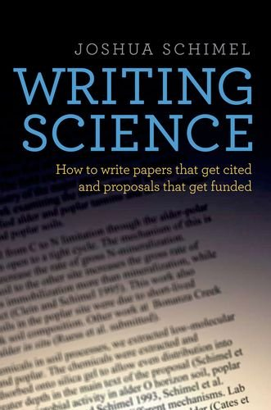
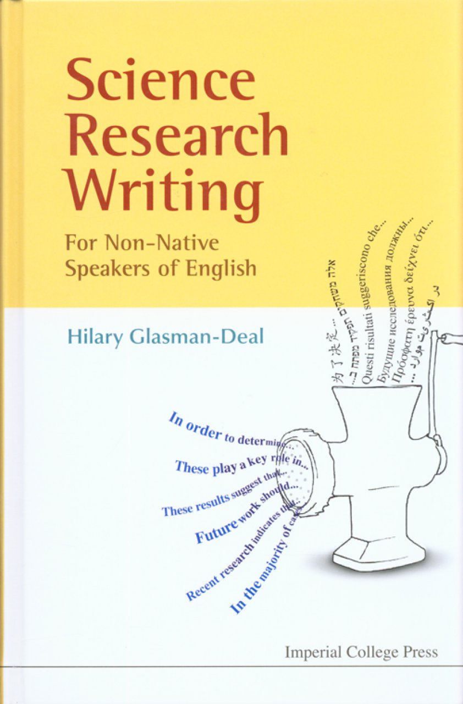
Maybe free access on campuses through Springer Link:
http://bit.ly/EloqSci
Gopen and Swan: “The Science of Scientific Writing”
www.eloquentscience.com

